Slide 1
Visualizing Data with
Snowsight Dashboards

Slide 2

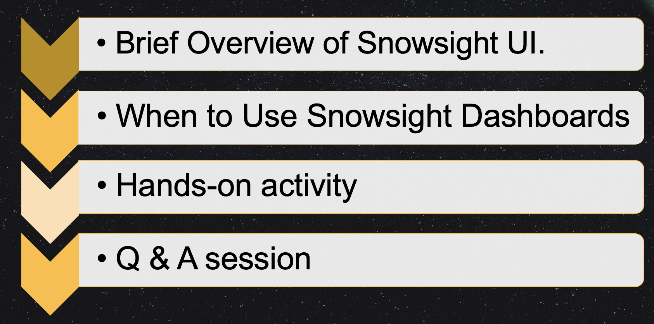
Agenda

Slide 3




When to Use Snowsight Dashboards
Ad hoc data analysis Visualize data with quick charts
and validation
Collaborate with ease

Slide 4

Prerequisites
Snowflake trial account
(Sign up for a free Snowflake trial account before the hands-on activity)
Note: If you have any issues with the above prerequisites, please reach out to the event organizers for assistance prior to the hands-on activity.

Slide 5
Hands-on activity
Steps involved:
Create two tables and load star wars data
Creating custom filters using the queries from GitHub
Building a Snowsight dashboard with the star wars dataset
Visit the link below to access the code for this activity
https://github.com/sheetaljgowda/Star_wars_data

Slide 6
Additional Resources
Snowflake documentation:
https://docs.snowflake.com/en/user-guide/ui-snowsight-visualizations
Snowflake Quickstarts :
https://quickstarts.snowflake.com/guide/security_dashboards_for_snowflake/

Slide 7
THANK You

